Slide 1

COMPUTER SCIENCE AND ENGINEERING
Plagiarism detection Using Artificial Intelligence
UNDER THE GUIDANCE OF :
Mr. P. CHALAPATHI RAO, M.Tech,(Ph.D.),
Assistant Professor,
Department of CSE
BATCH NO :19
CH. TEJA SRINIVAS 216M1A0509
G. SWAPNA 216M1A0525
K. LALITH VARDHAN 216M1A0552
R. LOKESH NARASIMHA MURTHY 216M1A05A8

Slide 2
ABSTRACT
Plagiarism relates to the act of taking information or ideas of someone else and demand it as our own. Basically, it reproduces the existing information in modified format. In every field of education, it becomes a serious issue. Various techniques and tools are derived these days to detect plagiarism. Various types of plagiarism are there like text matching, copy paste, grammar-based method etc. This study explores an advanced plagiarism detection system leveraging BERT (Bidirectional Encoder Representations from Transformers) and Artificial Intelligence(AI) algorithms to enhance the accuracy of text similarity analysis. The system utilizes the Google Custom Search API to fetch relevant web sources and compares the uploaded text against publicly available content.

Slide 3
CONTENTS:
1. Introduction 2. Existing System 3. Proposed System 4. Algorithms 5. Key Differences (Existing vs Proposed) 6. Class Diagram 7. Sequence Diagram 8. System Architecture
9. Implementation
10. Testing and Validation
11. Test Cases​
12. Output Screenshots​
13. Conclusion​

Slide 4
INTRODUCTION
Plagiarism is a major concern in academics and research, as traditional text-matching methods fail to detect paraphrased content. This project uses BERT (Bidirectional Encoder Representations from Transformers) to analyze text similarity and identify plagiarism more accurately. It operates in two modes: an offline mode, where documents are compared using BERT, and an online mode, which utilizes Google Custom Search API to check for matches across the web. By detecting both exact and reworded content, the system provides a plagiarism percentage, ensuring originality verification for students, educators, and researchers.

Slide 5
EXISTING SYSTEM
Existing plagiarism detection systems use string matching, tokenization, and word frequency analysis to find similarities in text. While effective for direct copying, they fail to detect reworded or paraphrased content, making it easy to bypass detection by altering phrasing without changing meaning.
Traditional systems lack real-time access to the entire web, limiting their ability to detect content copied from blogs, news sites, or social media. They also generate false positives for common phrases and citations. An advanced AI-driven approach is needed to identify both exact matches and paraphrased text beyond stored databases.

Slide 6
PROPOSED SYSTEM
The proposed plagiarism detection system uses BERT to analyze text similarity with greater accuracy. Unlike traditional string-matching, BERT understands word and sentence context, detecting paraphrased and restructured content. It operates in offline mode, comparing documents locally, and online mode, integrating Google Custom Search API for web-based plagiarism checks.
To improve efficiency, the system preprocesses text by removing special characters, tokenizing sentences, and converting them into numerical representations for BERT analysis. A similarity score determines plagiarism, with a set threshold marking copied content. Supporting multiple file formats like PDF and DOCX, this AI-driven approach enhances accuracy and scalability for content verification.

Slide 7
ALGORITHMS
Our system leverages advanced Natural Language Processing (NLP) techniques to detect plagiarism efficiently. The two core algorithms used are:
BERT (Bidirectional Encoder Representations from Transformers)
Understanding the deep semantic meaning of text.
BERT is a transformer-based learning model that understands text contextually rather than just by individual words. This makes it highly effective in detecting paraphrased content, where word structures are changed but meaning remains the same.
2. Cosine Similarity for Text Comparison
Measuring the similarity between two text samples.
Text is converted into vector representations using BERT embeddings.
Cosine Similarity= A⋅B/ ∣∣A∣∣×∣∣B∣∣ ​

Slide 8
Key differences between existing system and proposed system
Detection Approach: Existing – Exact Matching, Proposed – AI Semantic Similarity.
Handling Paraphrased Content: Existing – Fails, Proposed – Detects.
Database Utilization: Existing – Static, Proposed – Dynamic.
False Positives: Existing – High, Proposed – Reduced.
Plagiarism Reports: Existing – Basic, Proposed – AI-Enhanced.

Slide 9

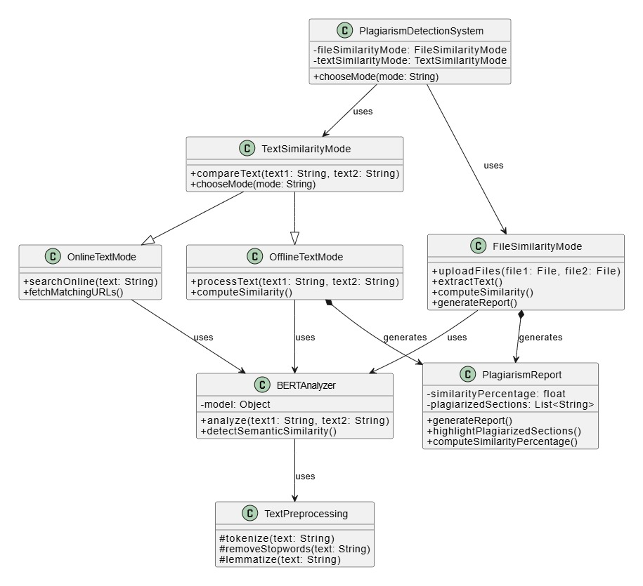
CLASS DIAGRAM

Slide 10
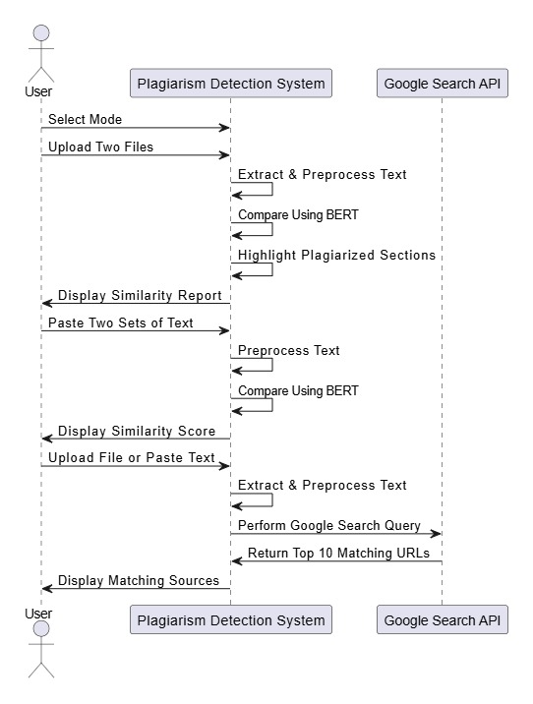
SEQUENCE DIAGRAM

Slide 11

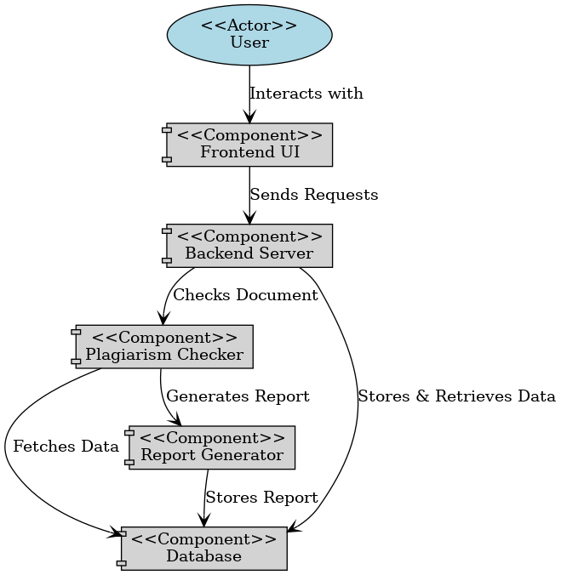
SYSTEM ARCHITECTURE

Slide 12
SYSTEM REQUIREMENTS
HARDWARE REQUIREMENTS:
System : Intel Core i3 (or equivalent) – 2.0 GHz or above
Hard Disk : 40 GB
Ram : 512 Mb
SOFTWARE REQUIREMENTS:
Operating system : Windows
Coding Language : python

Slide 13
IMPLEMENTATION
The Plagiarism Detection System is built as a modular and scalable framework, ensuring efficient processing, accurate similarity detection, and detailed result reporting. It follows a pipeline architecture, where each module handles a specific stage of analysis in sequence.
Modules:
Text Preprocessing Module
Vector Embeddings and Feature Extraction Module
Semantic Similarity Detection Module
Document Similarity Checking Module
Report Generation and Visualization Module

Slide 14
TESTING AND VALIDATION
Testing ensures the software meets functional and performance requirements. Validation confirms the final product matches user expectations.
Unit Testing : Tests individual components or functions in isolation.
Functional Testing: Tested API routes using Postman with various text and file inputs.
Black box Testing: Tests the system without looking into internal code.
Performance Testing: Measured response time for different file sizes and input complexity.
Tools Used
Python unit test (Unit Testing):
Used to test individual functions like preprocess() and check_similarity() in isolation.
Helped to ensure correctness and consistency of core logic.
2. Postman (for API Testing).
Tested Flask routes like /send,/compare,/check_plagiarism methods
Sent various requests with different payloads (PDF,DOCX<txt) and checked responses.
3. Invalid input handling
Manually tested edge cases like empty uploads, non-PDF/DOCX file types and short text inputs.

Slide 15
TEST CASES
Test Case No. | Test Scenario | Expected Output | Pass/Fail
1 | Uploads DOCX File in file Similarity mode. | Extracted Text appears in UI | Pass
2 | Compares two DOCX files for similarity. | Plagiarism Percentage displayed. | Pass
3 | Uploads PDF file in Online mode. | Extracted text appears, Google search performed. | Pass
4 | Paste text in Offline mode | Similarity score displayed. | Pass
5 | Paste Paraphrased text to check BERTs accuracy. | Plagiarism Detected. | Pass
6 | Runs Google Search API. | Top 10 URLs Returned. | Pass
7 | Upload an unsupported file type. | Error message displayed. | Pass
8 | Handle API Failure gracefully. | System shows “No Internet connection error” | Pass
9 | Integration of front-end and back-end. | Similarity and URLs displayed. | Pass

Slide 16
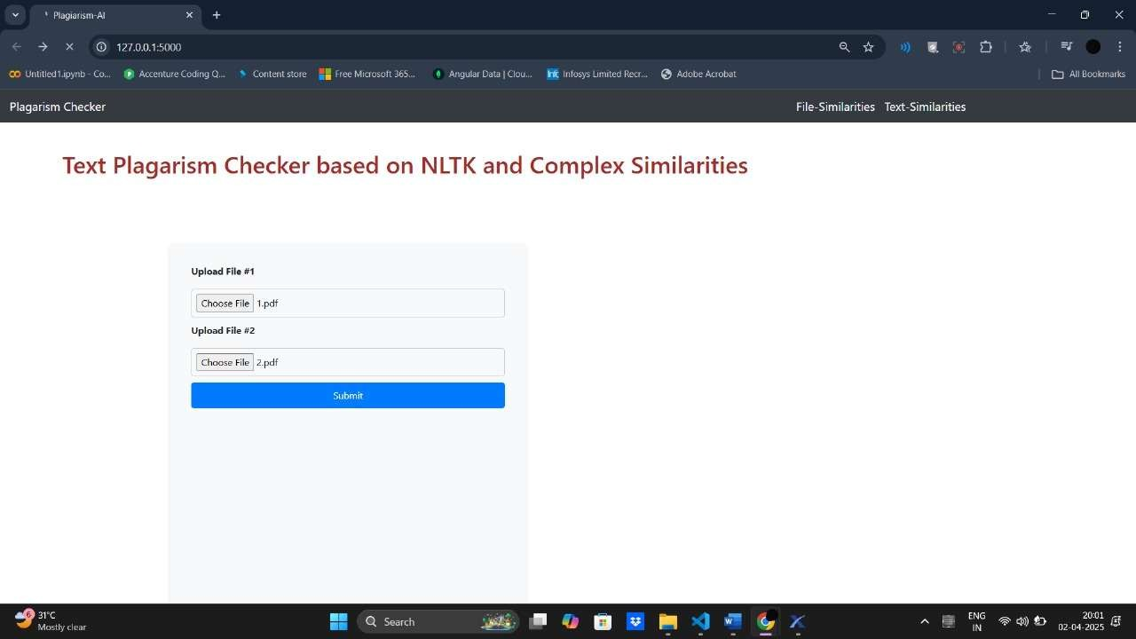
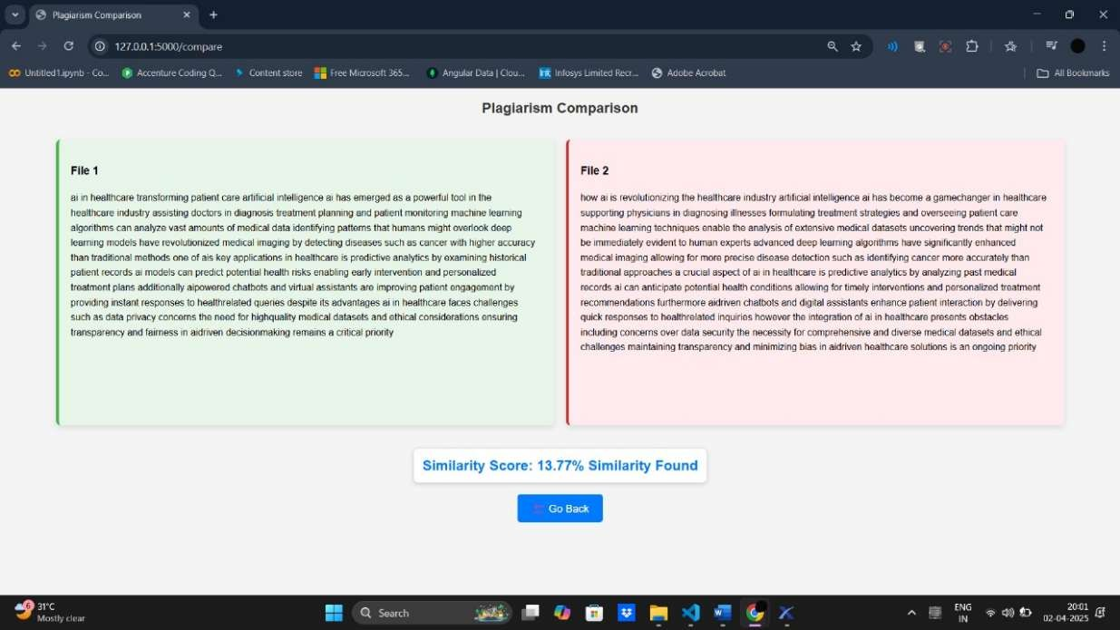
OUTPUT SCREENSHOTS
The output screenshots section provides visual documentation of how the system responds to user inputs, demonstrates the functionality, and verifies the performance of the machine learning model in real-time applications. These screenshots also showcase the results of predictions, indicating the system's detection capabilities.
Fig: This is the main page of the Plagiarism Checker web application, running locally on 127.0.0.1:5000, indicating it's built with Flask.
Fig: The screenshot confirms that the application is searching for matching sources online after uploading a PDF file or entering text

Slide 17
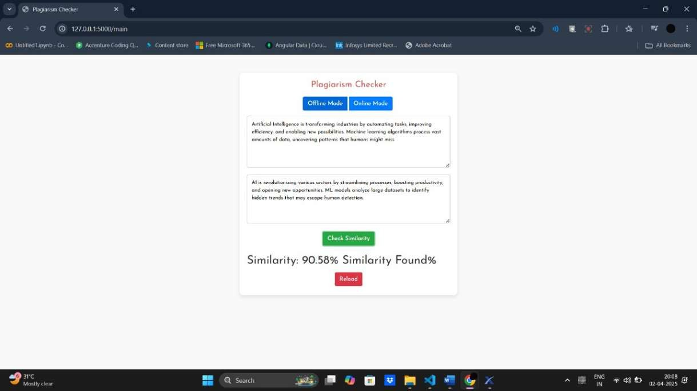
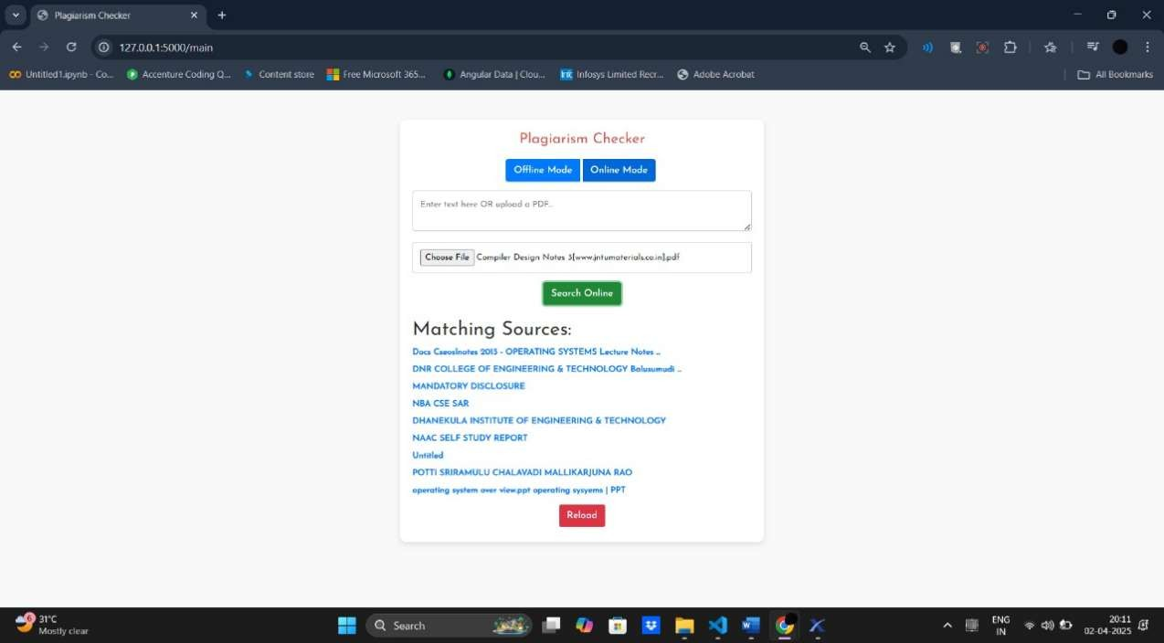
Fig 9.3: The screenshot represents a BERT-based plagiarism detection system, where two text files are compared for similarity
Fig 9.4: The screenshot confirms that the application is searching for matching sources online after uploading a PDF file or entering text.

Slide 18
Conclusion
CONCLUSION
This project’s plagiarism detection system checks for similarities between uploaded content and online sources using the Google Custom Search API. It analyzes the percentage of similarity and provides source links to help users check originality. If the similarity score is low (0-40%), the content is likely original, while a high score (above 40%) suggests significant overlap and needs further review. However, the system has some limitations, such as relying on online sources, struggling with paraphrased content, and API restrictions, so results should be interpreted carefully. Despite these challenges, this tool is useful for students, researchers, and professionals to ensure content authenticity. This project highlights the importance of automated plagiarism detection in maintaining originality and academic integrity.

Slide 19
Future enhancement
As AI gets better, plagiarism checkers will also improve. They’ll be able to understand the meaning behind words, so they can catch copied ideas and tricky rewording more accurately, without making as many mistakes. They’ll also be able to spot text written by AI tools like ChatGPT or Gemini by studying how the writing is structured.
These tools will work across different languages too, finding copied content that’s been translated or rewritten. In the future, they won’t just point out problems they’ll also give helpful tips on how to rephrase things the right way and add proper citations. Overall, plagiarism detection will become smarter, fairer, and more helpful for writers everywhere.

Slide 20
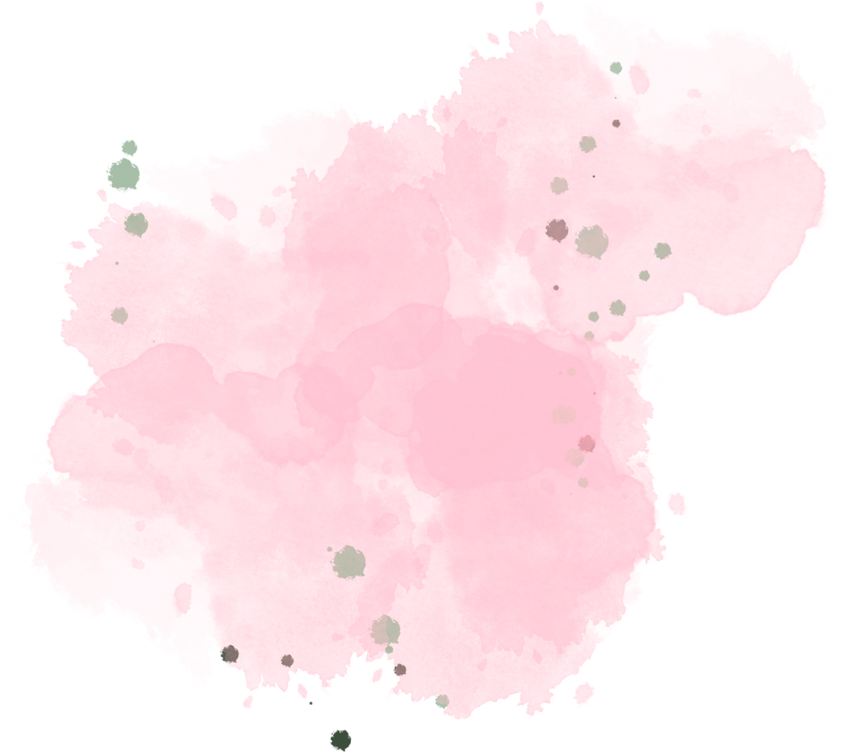
Thank You

